Slide 1
Graph Analytics- Property Graph, Graph Operators, Distributed Graph

Slide 2
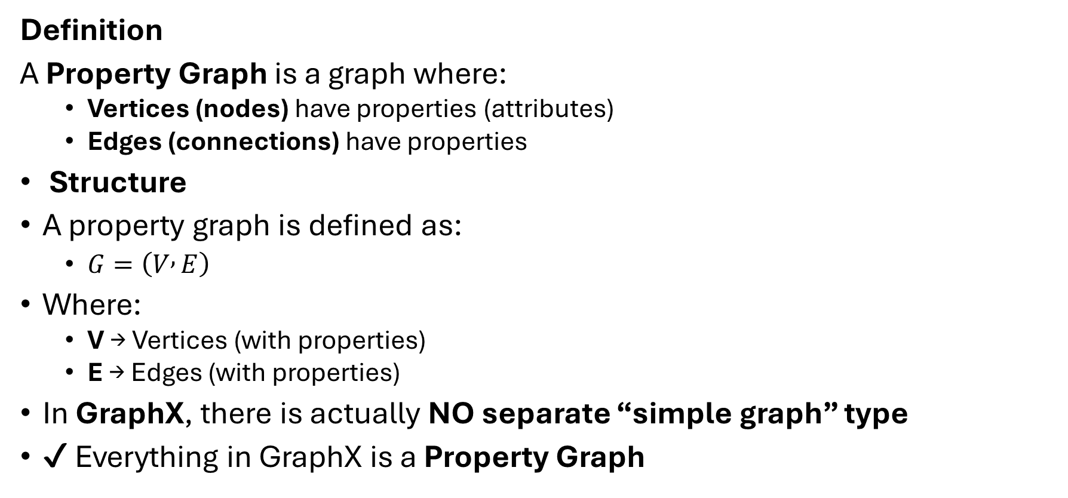
Property Graphs
Definition
A Property Graph is a graph where:
Vertices (nodes) have properties (attributes)
Edges (connections) have properties
Structure
A property graph is defined as:
$G=\left(V , E\right)$
Where:
V → Vertices (with properties)
E → Edges (with properties)
In GraphX, there is actually NO separate “simple graph” type
✔ Everything in GraphX is a Property Graph

Slide 3
It is widely used in:
Social networks (users, friendships)
Recommendation systems
Fraud detection

Slide 4
Edges (Relationships)
Vertices (People)
ID | Name | City | Age
1 | Naren Rao | Hyderabad | 27
2 | Rahul | Warangal | 30
3 | Ganesh | Nizamabad | 28
From | To | Relation
1 | 2 | Friend
2 | 3 | Colleague
3 | 1 | Relative

Slide 5
Property Graph Example:
// Graph
val graph = Graph(vertices, edges)
// Output
graph.vertices.collect.foreach(println)
graph.edges.collect.foreach(println)
Output:
(1,(Naren Rao,Hyderabad,27)) (2,(Rahul,Warangal,30)) (3,(Ganesh,Nizamabad,28)) Edge(1,2,Friend) Edge(2,3,Colleague) Edge(3,1,Relative)
import org.apache.spark.graphx._
import org.apache.spark.rdd.RDD
// Vertices
val vertices = sc.parallelize(Array(
(1L, ("Naren Rao", "Hyderabad", 27)),
(2L, ("Rahul", "Warangal", 30)),
(3L, ("Ganesh", "Nizamabad", 28))
))
// Edges
val edges = sc.parallelize(Array(
Edge(1L, 2L, "Friend"),
Edge(2L, 3L, "Colleague"),
Edge(3L, 1L, "Relative")
))

Slide 6
Simple Graph
“You only know who is connected to whom”
Example:
Rahul knows Ganesh
Property Graph
“You know who + details about them”
Example:
Rahul (Age 30, Warangal) knows
Ganesh (Age 28, Nizamabad)
since 2020
One-line Difference
👉 Graph = Structure 👉 Property Graph = Structure + Data
A simple graph contains only vertices and edges representing relationships, whereas a property graph includes additional attributes for both vertices and edges, making it suitable for real-world applications like social networks.

Slide 7
Graph Operators
Definition
Graph Operators are functions used to:
Transform graph data
Filter graph structure
Compute metrics
They work on:
Graph[VD, ED]
VD → Vertex Data
ED → Edge Data

Slide 8
Types of Graph Operators
Type | Purpose
1. Map Operators | Modify data
2. Structural Operators | Change graph structure
3. Join Operators | Combine external data
4. Aggregation Operators | Compute values

Slide 9
Base Graph (Used for All Examples)
import org.apache.spark.graphx._ // Vertices val vertices = sc.parallelize(Array( (1L, ("Naren Rao", "Hyderabad", 27)), (2L, ("Rahul", "Warangal", 30)), (3L, ("Ganesh", "Nizamabad", 28)) ))
// Edges val edges = sc.parallelize(Array( Edge(1L, 2L, "Friend"), Edge(2L, 3L, "Colleague"), Edge(3L, 1L, "Relative") )) val graph = Graph(vertices, edges)

Slide 10
1. MAP OPERATORS
1.1 mapVertices()
Modify vertex data
val updatedGraph = graph.mapVertices { case (id, (name, city, age)) => (name, city, age + 5) } updatedGraph.vertices.collect.foreach(println)
Output:
(1,(Naren Rao,Hyderabad,32))
(2,(Rahul,Warangal,35))
(3,(Ganesh,Nizamabad,33))

Slide 11
1.2 mapEdges()
Modify edge data
val newEdgesGraph = graph.mapEdges(edge => edge.attr + "_Strong") newEdgesGraph.edges.collect.foreach(println)
Output
Edge(1,2,Friend_Strong) Edge(2,3,Colleague_Strong) Edge(3,1,Relative_Strong)

Slide 12
1.3 mapTriplets() (Important)
Access both vertex + edge data
val tripletGraph = graph.mapTriplets(triplet => triplet.srcAttr._1 + " knows " + triplet.dstAttr._1 ) tripletGraph.edges.collect.foreach(println)
Output
Edge(1,2,Naren Rao knows Rahul) Edge(2,3,Rahul knows Ganesh) Edge(3,1,Ganesh knows Naren Rao)

Slide 13
2. STRUCTURAL OPERATORS
2.1 subgraph()
Filter vertices
val subGraph = graph.subgraph(vpred = (id, attr) => attr._3 > 28) subGraph.vertices.collect.foreach(println)
Output
(2,(Rahul,Warangal,30))

Slide 14
2.2 reverse()
Reverse edge direction
val reversedGraph = graph.reverse reversedGraph.edges.collect.foreach(println)
Output
Edge(2,1,Friend) Edge(3,2,Colleague) Edge(1,3,Relative)

Slide 15
4.3 union()
Combine two graphs
val graph2 = graph.mapVertices { case (id, (name, city, age)) => (name, city, age + 1) } val combined = graph.union(graph2) println("Vertices count: " + combined.vertices.count())
Output
Vertices count: 6

Slide 16
3. AGGREGATION OPERATORS
3.1 degrees()
val degrees = graph.degrees degrees.collect.foreach(println)
Output
(1,2) (2,2) (3,2)
3.2 inDegrees()
graph.inDegrees.collect.foreach(println)
Output
(1,1) (2,1) (3,1)
3.3 outDegrees()
graph.outDegrees.collect.foreach(println)
Output
(1,1) (2,1) (3,1)
Base Graph output(for reference):
(1,(Naren Rao,Hyderabad,27)) (2,(Rahul,Warangal,30)) (3,(Ganesh,Nizamabad,28)) Edge(1,2,Friend) Edge(2,3,Colleague) Edge(3,1,Relative)

Slide 17
3.4 reduce (Influencer)
val maxDegree = graph.degrees.reduce( (a, b) => if (a._2 > b._2) a else b ) println("Influential Person: " + maxDegree)
Output
Influential Person: (1,2)
(1,(Naren Rao,Hyderabad,27)) (2,(Rahul,Warangal,30)) (3,(Ganesh,Nizamabad,28))
Edge(1,2,Friend) Edge(2,3,Colleague) Edge(3,1,Relative)

Slide 18
4. JOIN OPERATORS
outerJoinVertices()
Add external data
val extraData = sc.parallelize(Array( (1L, "Engineer"), (2L, "Manager"), (3L, "Student") )) val joinedGraph = graph.outerJoinVertices(extraData) { case (id, (name, city, age), job) => (name, city, age, job.getOrElse("Unknown")) } joinedGraph.vertices.collect.foreach(println)
Output
(1,(NarenRao,Hyderabad,27,Engineer)) (2,(Rahul,Warangal,30,Manager)) (3,(Ganesh,Nizamabad,28,Student))

Slide 19
5. Triplets (important)
Triplet = (Source Vertex + Edge + Destination Vertex)
Example:
graph.triplets.collect.foreach(println)
Output
((1,(Naren Rao,Hyderabad,27)),2,(Rahul,Warangal,30),Friend)

Slide 20
Summary about graph operators
Operator | Real Meaning
mapVertices | Update user data
mapEdges | Update relationship
subgraph | Filter users
degrees | Find influencers
reverse | Reverse network
join | Add external info

Slide 21
Distributed Graph (in GraphX)
A Distributed Graph is a graph whose vertices and edges are partitioned and processed across multiple machines (cluster nodes) using Apache Spark.
Key Idea
Instead of storing the graph in one system:
Data is split into parts
Each part runs on different machines
Computation happens in parallel

Slide 22
2. How GraphX Represents Distributed Graph
GraphX internally stores graph as:
Graph[VD, ED]
Which is actually:
VertexRDD[VD] → distributed vertices
EdgeRDD[ED] → distributed edges
Both are RDDs (distributed datasets)
Conclusion on Definition:
Distributed Graph means:
Graph data is partitioned across cluster
Uses RDDs
Enables parallel graph processing

Slide 23
Example
Person | City
Naren Rao | Hyderabad
Rahul | Warangal
Ganesh | Nizamabad
Connections:
Naren Rao → Rahul
Rahul → Ganesh
Distributed View: Graph is split across machines
Machine 1 | Machine 2
Naren Rao | Rahul
Edge(1→2) | Edge(2→3)

Slide 24
Scala Program (spark-shell)
// Create graph
val graph = Graph(vertices, edges)
// Operations
println("Total Users: " + graph.vertices.count())
println("Total Connections: " + graph.edges.count())
Output
Total Users: 1000000 Total Connections: 999999
import org.apache.spark.graphx._
// Large distributed vertices
val vertices = sc.parallelize(
(1L to 1000000L).map(id =>
(id, ("User" + id, "Telangana", 25))
)
)
// Large distributed edges
val edges = sc.parallelize(
(1L to 999999L).map(id =>
Edge(id, id + 1, "connected")
)
)

Slide 25
Step 1: Create Vertices
(1L to 1000000L).map(...)
Creates 1 million users
Example:
User1
User2
…
Distributed across cluster
Step 2: Create Edges
Edge(id, id + 1, "connected")
Creates connections like:
User1 → User2
User2 → User3

Slide 26
Step 3: Graph Creation
val graph = Graph(vertices, edges)
GraphX internally:
Splits vertices across nodes
Splits edges across nodes
Step 4: Count
graph.vertices.count()
Distributed computation happens
Each node counts its partition

Slide 27
Why Distributed Graph is Needed?
Problem (Single Machine)
Cannot handle:
Millions of users
Billions of connections
Solution (Distributed Graph)
✔ Parallel processing ✔ Scalable ✔ Fault-tolerant

